Slide 1

SATS PROJECT SPEAR · USE CASE 2
AI Operations
Control Tower
To-Be architecture diagrams
and next steps
Prototype and production target, mapped to functional and non-functional requirements
Next steps: slides 2 and 10
Draft for validation · 28 October 2026
Notes:
Cover. Architecture diagrams for the AI Operations Control Tower (Use Case 2) and the next steps to reach the MVP build. Built from the Requirements Definition and the Solution Envisioning Output. Cover photograph is generated imagery, illustrative only.

Slide 2
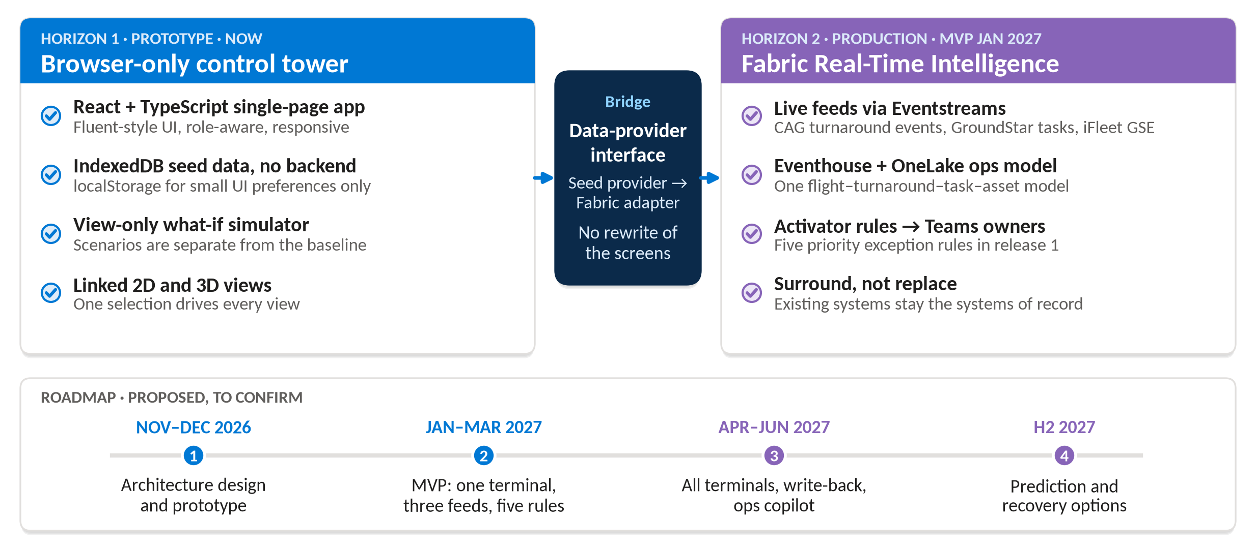
APPROACH
One UI, two data horizons
Source: Requirements Definition sections 1 and 13; Solution Envisioning Output slides 14, 16 and 17
Notes:
The requirements definition scopes a browser-storage prototype; the envisioning output defines the Fabric production target. The data-provider interface from requirements section 13 lets a Fabric adapter replace the seed provider without rewriting the screens. Roadmap is proposed and to be confirmed.

Slide 3
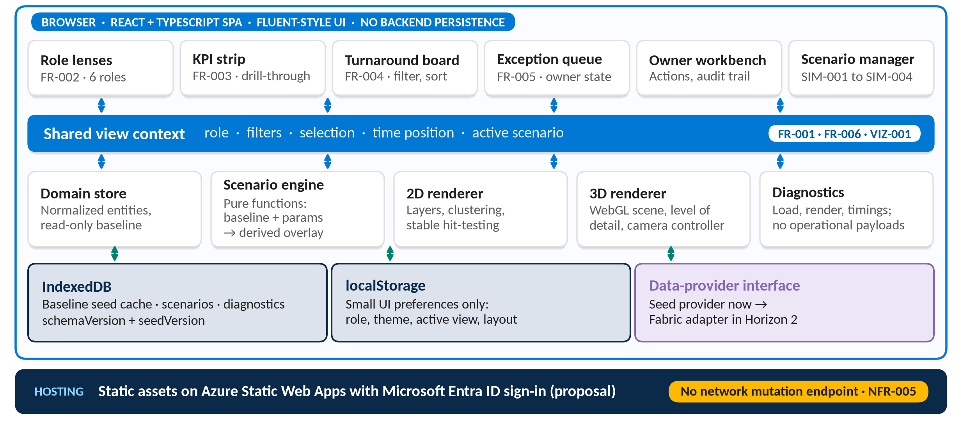
TO-BE · HORIZON 1
Prototype runs entirely in the browser
Source: Requirements Definition sections 8, 10 and 13; Microsoft Learn: What is Azure Static Web Apps?
Notes:
Component split follows Requirements Definition section 13. IndexedDB holds entities and scenarios; localStorage holds small preferences only (DATA-002). Azure Static Web Apps hosting is a design proposal, not stated in the source.

Slide 4
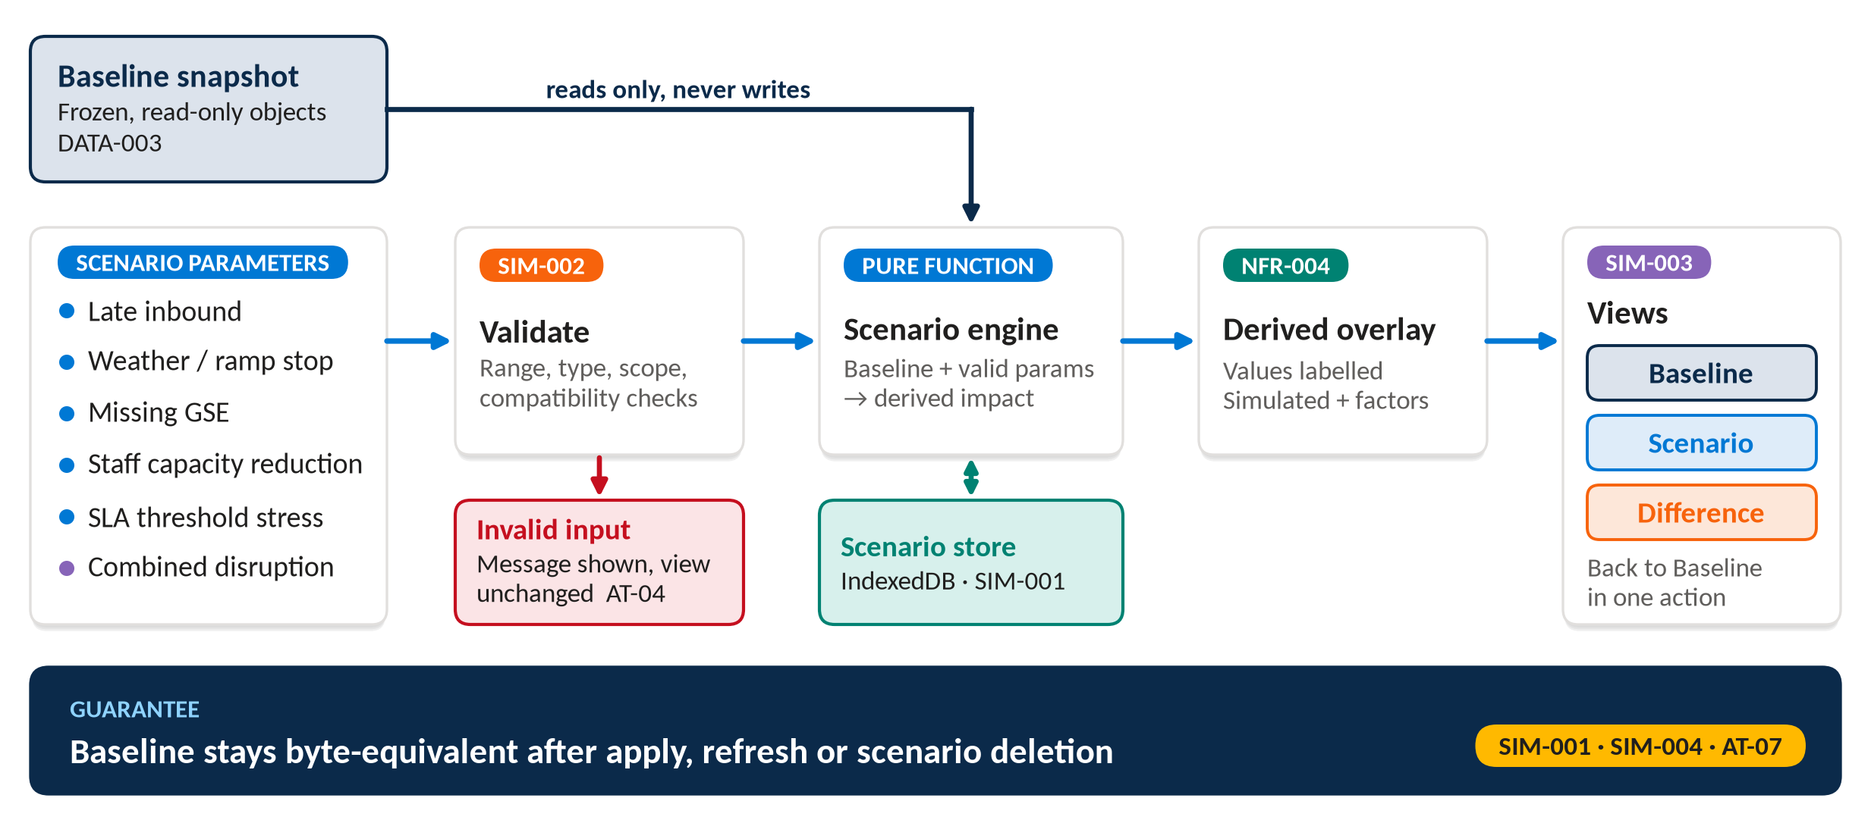
TO-BE · SIMULATOR
What-if runs beside the baseline
Source: Requirements Definition sections 6, 8 and 12 (SIM-001 to SIM-004, DATA-003, AT-03, AT-04, AT-07)
Notes:
The scenario engine only reads the baseline. Invalid parameters show a message and leave the view unchanged (AT-04). Baseline remains byte-equivalent after apply, refresh or deletion.

Slide 5
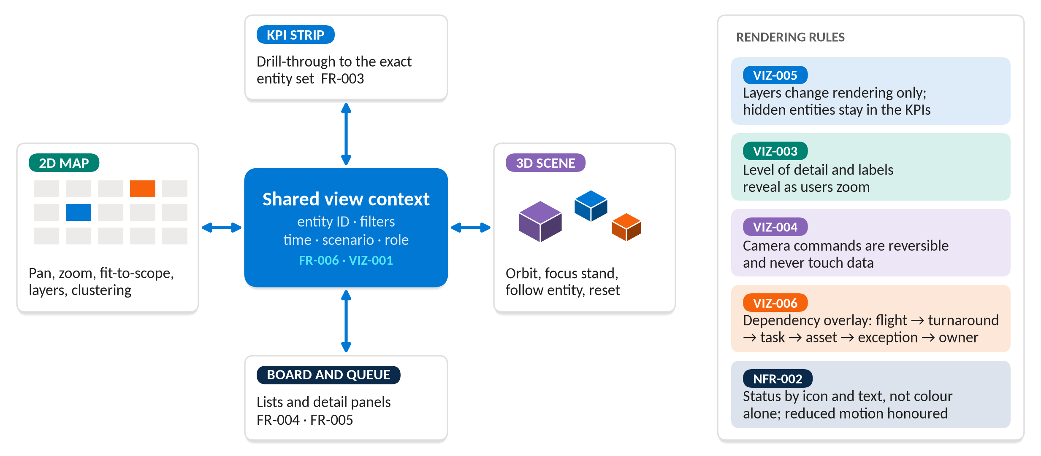
TO-BE · 2D / 3D
One selection drives every view
Source: Requirements Definition section 5 (VIZ-001 to VIZ-006), FR-006, NFR-002; production option: Microsoft Learn, What is Fabric Maps?
Notes:
Toggling 2D and 3D preserves filters, selection, time position and simulation context (VIZ-001, AT-02). In production, Fabric Maps can render live Eventhouse queries and Lakehouse reference data as layers.

Slide 6
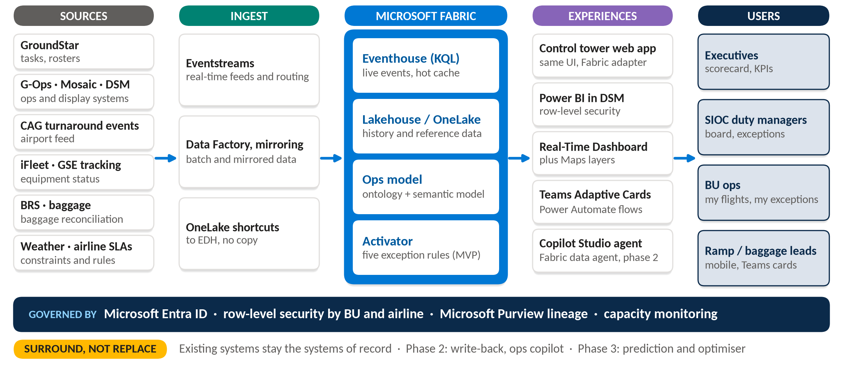
TO-BE · HORIZON 2
Fabric surrounds today's systems
Source: Solution Envisioning Output slides 14-16; Microsoft Learn: Real-Time Intelligence overview, Fabric Activator, Fabric data agent in Copilot Studio
Notes:
Aligned to the envisioning target architecture (surround, not replace). Added: the same control tower web app reading Fabric through the data-provider adapter, and an ops model expressed as a Fabric ontology (ontology and digital twin builder are in preview). Reference pattern: Azure Architecture Center, Real-time analytics with Azure Service Bus and Microsoft Fabric.

Slide 7
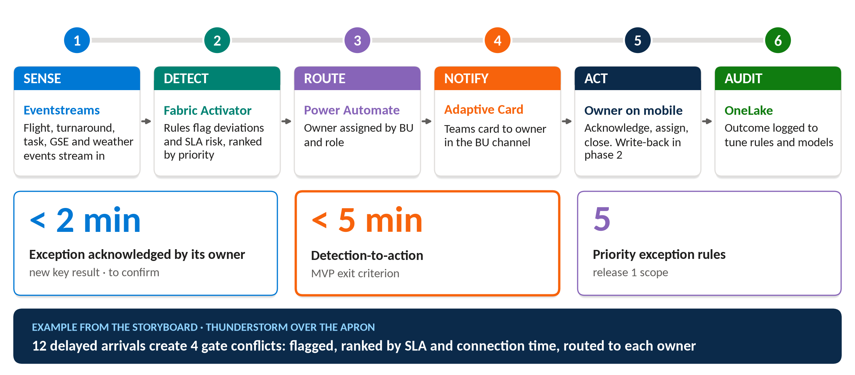
TO-BE · RUNTIME FLOW
Exceptions reach an owner in minutes
Source: Solution Envisioning Output slides 3, 11, 14 and 17; Microsoft Learn: What is Fabric Activator?
Notes:
Targets come from the envisioning output and are to be confirmed with SATS. Write-back to GroundStar and G-Ops is phase 2; the prototype has no write-back (NFR-005).

Slide 8
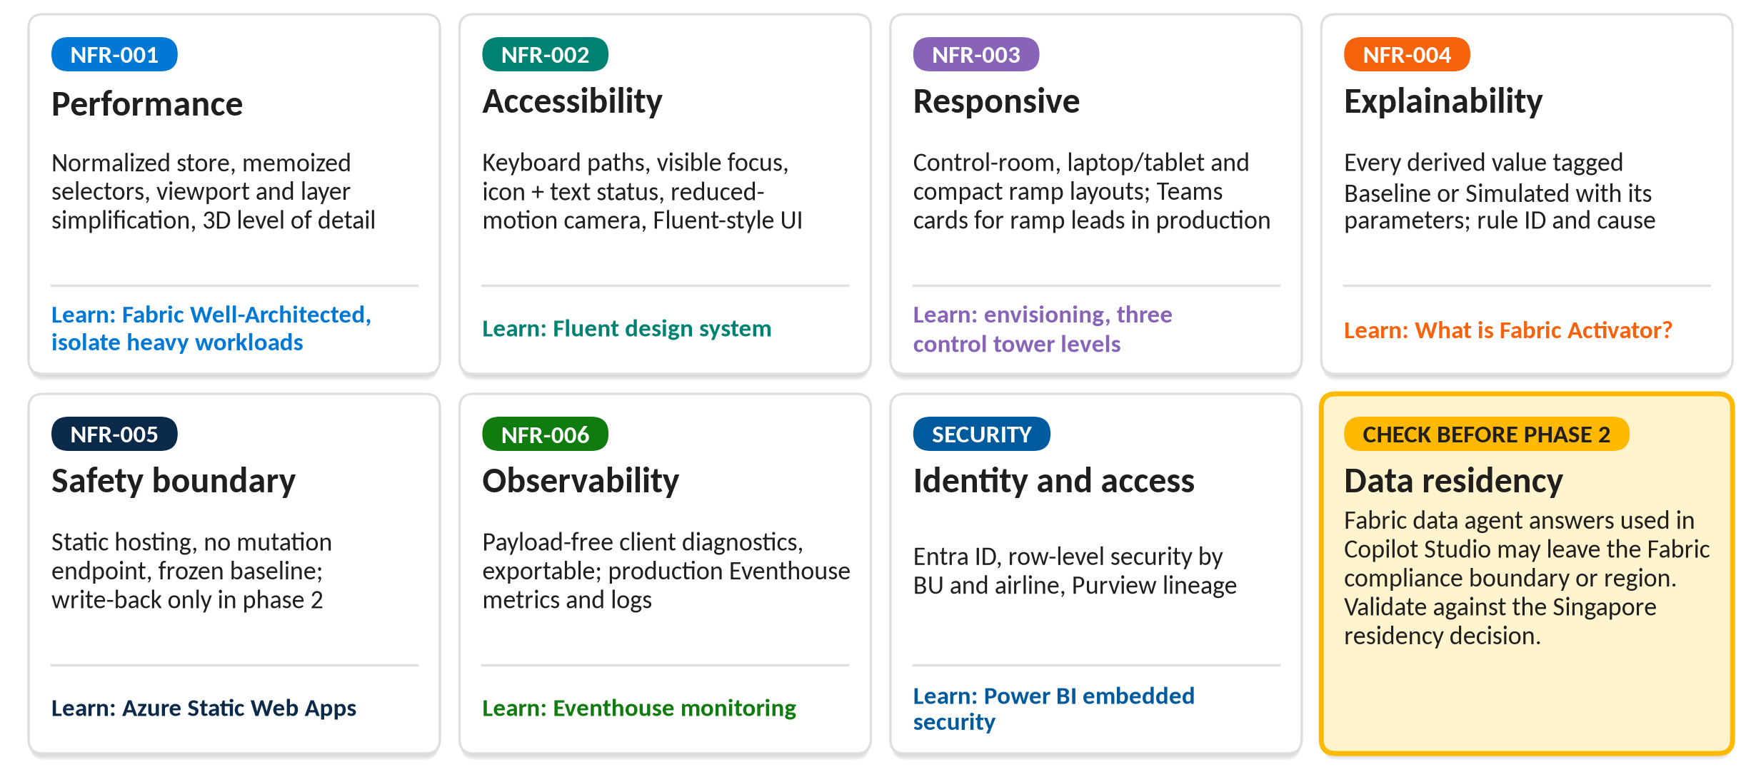
NON-FUNCTIONAL REQUIREMENTS
Each quality target has an answer
Source: Requirements Definition section 10; Microsoft Learn guidance named on each card
Notes:
Fabric data agent responses consumed in Copilot Studio might be sent outside the Fabric compliance boundary or region (Microsoft Learn). Validate against the Singapore residency decision before phase 2.

Slide 9
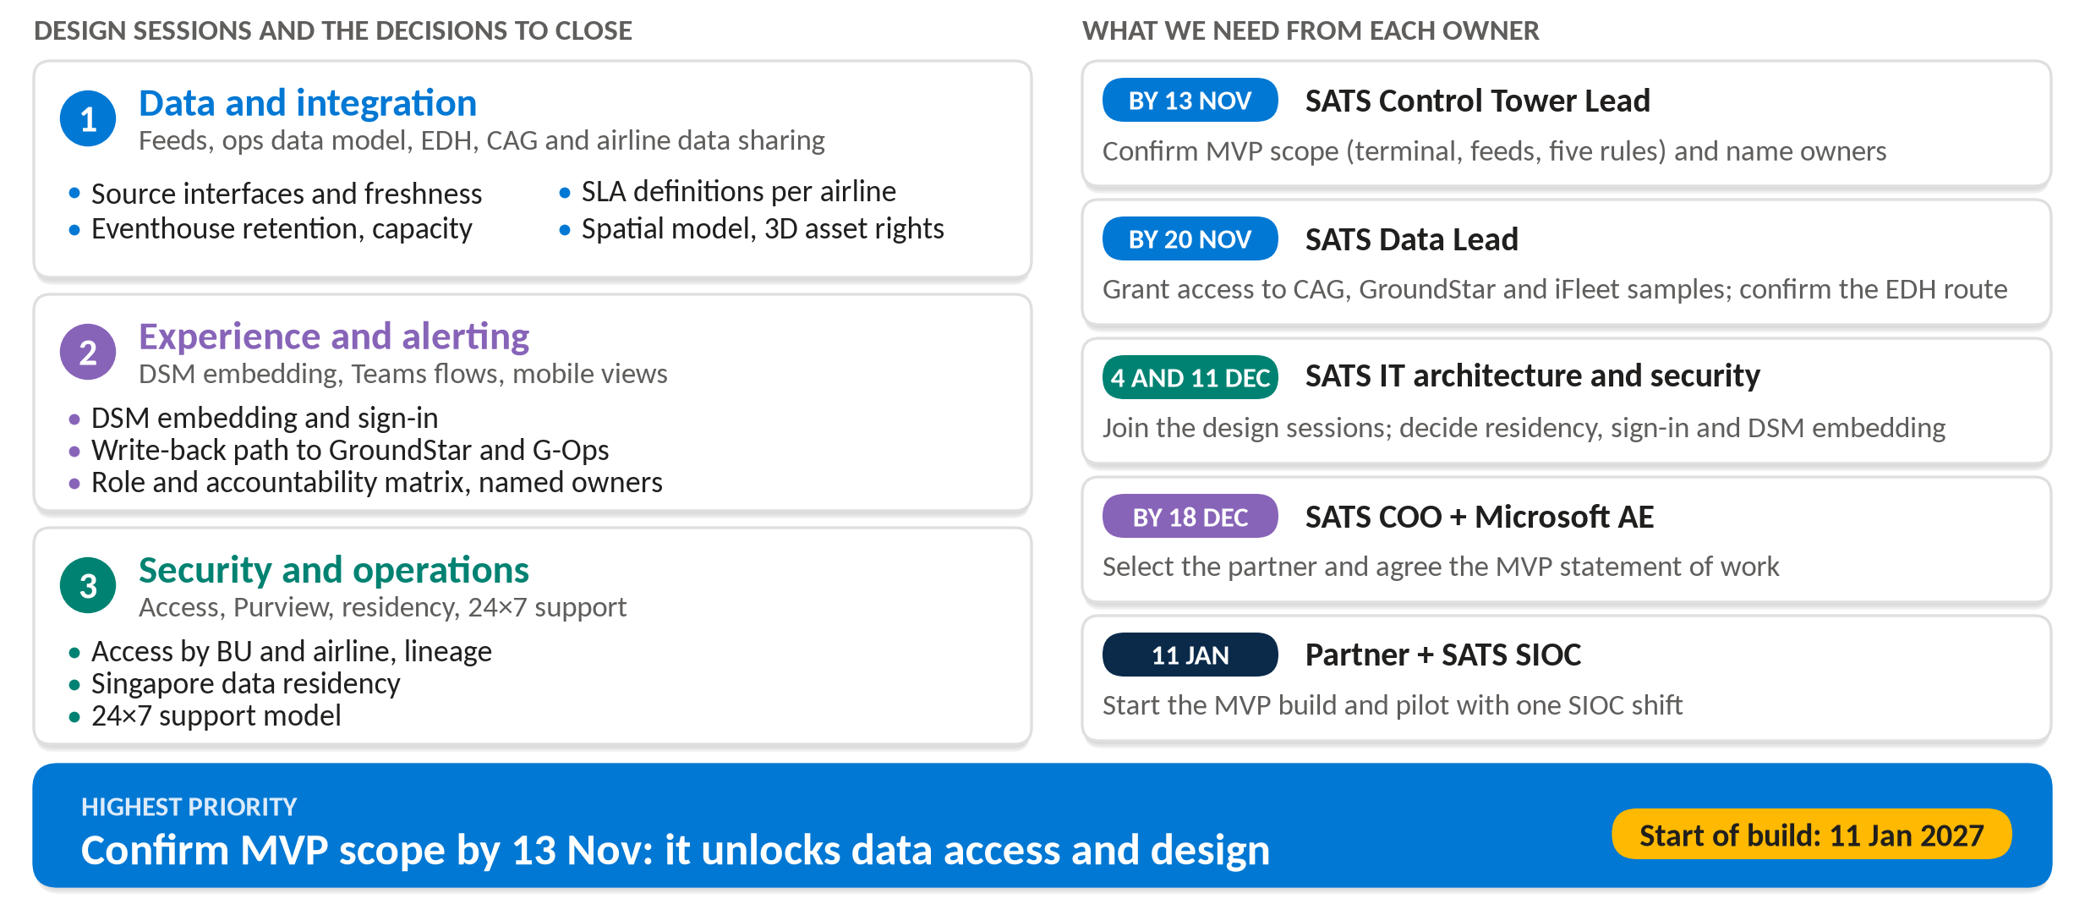
NEXT STEPS · OWNERS AND DECISIONS
Next steps: owners and decisions
Source: Solution Envisioning Output slides 15 and 18; Requirements Definition section 15
Notes:
Highest priority: SATS Control Tower Lead confirms MVP scope by 13 Nov. Per-owner asks are derived from the envisioning next steps and the open decisions in both documents.

